Slide 1

Cyber Defense Organization
Fall 2018 - Intro to Windows

Slide 2
PSA
Reset your Chegg account.
https://techcrunch.com/2018/09/26/chegg-resets-40-million-user-passwords-after-data-breach/
Twitter DMs were vulnerable
“If you interacted with an account or business on Twitter that relied on a developer using the AAAPI to provide their services, the bug may have caused some of these interactions to be unintentionally sent to another registered developer”
https://www.cyberscoop.com/twitter-api-bug/

Slide 3
Small Term of the Week: CVSS Score
The Common Vulnerability Scoring System (CVSS) is the industry standard method to evaluate and explain a vulnerability from its security implications perspective.
Scores range from 0 to 10, with 10 being the most severe. (Arbitrary Remote Code Execution).

Slide 4

Example: Shell Shock
CVE-2014-6271
Base Score: 10.0 HIGH
Vector: (AV:N/AC:L/Au:N/C:C/I:C/A:C)
Access Vector (AV): Network
Access Complexity (AC): Low
Authentication (AU): None
Confidentiality (C): Complete
Integrity (I): Complete
Availability (A): Complete

Slide 5
Survey. Which do you think is most popular?
Mac?
Linux?
Windows?

Slide 6
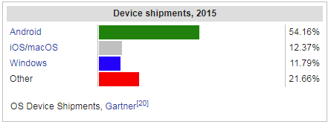
Trick Question: Android
Cite:Wikipedia

Slide 7
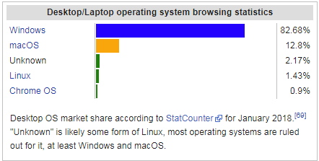
Desktop Browser
Us chromebook users will slowly take over!

Slide 8
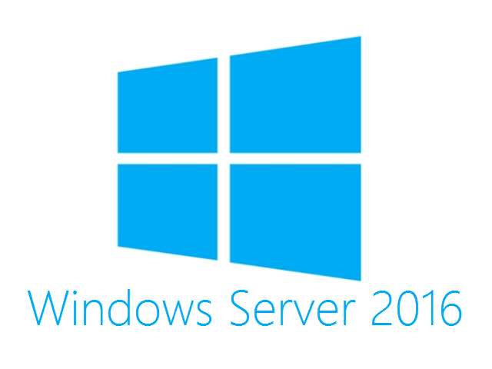
On to Windows proper
What is it?
-Basically a Windows 10 box with a bunch of possibilities built-in.
-Most importantly: It has a GUI. (Take that Linux Servers).

Slide 9
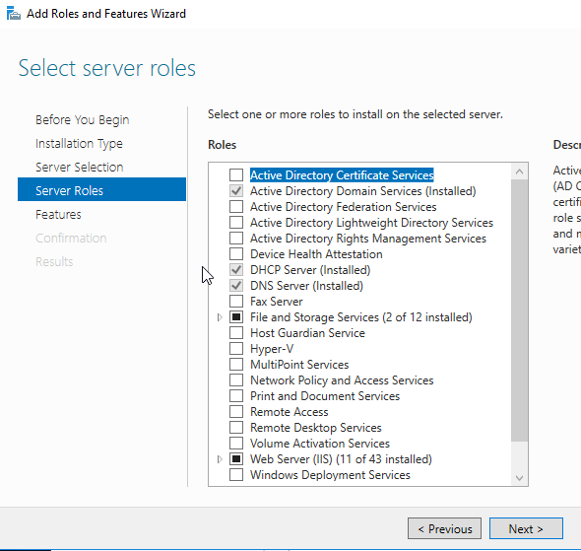
So what can it do? (And let’s look at that)
SMB Server
- FTP Server
- Exchange Server
- Application deployment
- Centralized monitoring
- VPN
- DNS
- IIS (web server)

Slide 10

Most important role: AD
Active Directory is the glue that holds the business world together.

Slide 11
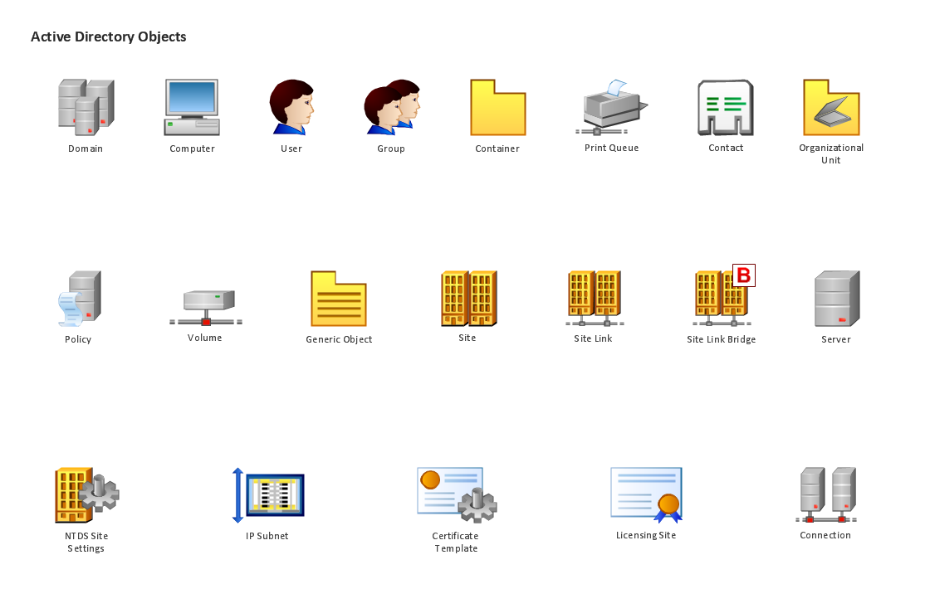
Parts of a domain: the problem

Slide 12
How the heck do you manage all that?
Prepare for messy graphic.

Slide 13
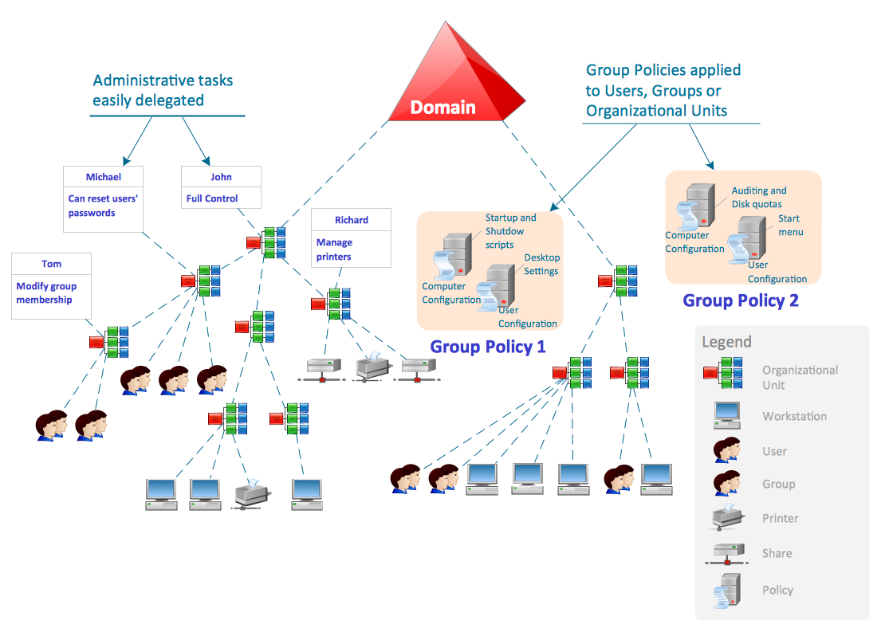

Slide 14
The Domain Controller
-It can retain information on computers, printers, and users.
-Give permissions to users based on their rank, or even what computer they log in on.

Slide 15
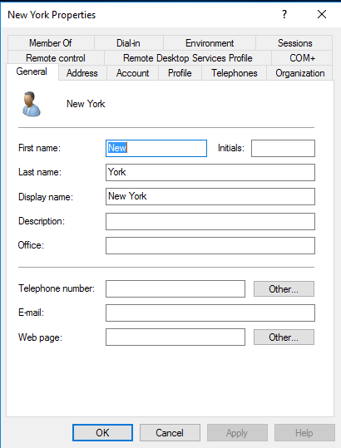
Users
Stores information on user
- Name
- Email
- Phone number
- Address
- Location in organization
- Password (hashed)

Slide 16
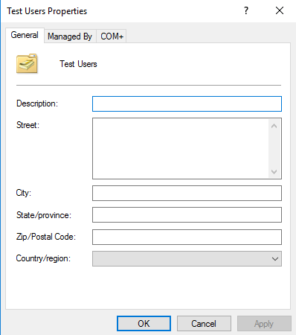
Organizational Units
-Allows us to create groups of users, computers, printers etc. and give specific options to them.
-Test users might have one right, while Executive users might have more.
- Helps keep an avalanche of people and things organized

Slide 17
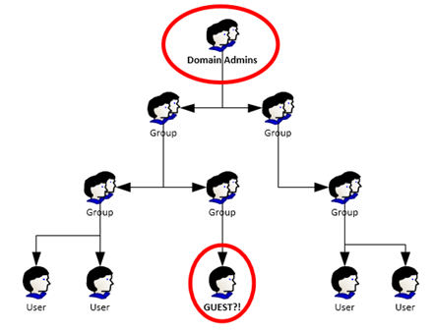
Nesting
Groups can be in groups. Yeah.
At this point you should preplan the domain around existing hierarchy.
Leads to inheritance rules which make me cry...especially when group policy.

Slide 18

Recap.
-Domains control network
- OU’s store information on things (objects)
- Groups contain objects
- Groups go in groups
- Windows is GUI frontend for a command line

Slide 19
Explore Active Directory
Tonight we will be using methods to understand and view this system.

Slide 20
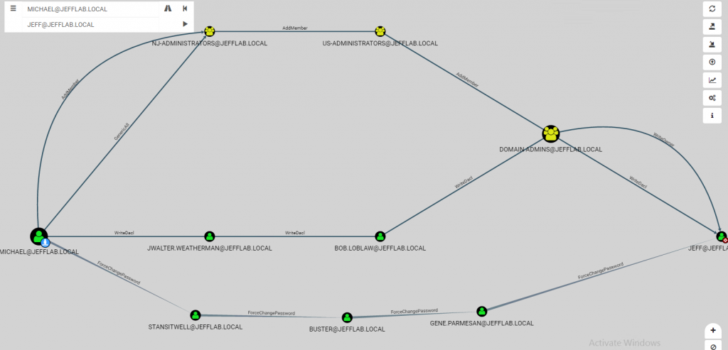

Slide 21

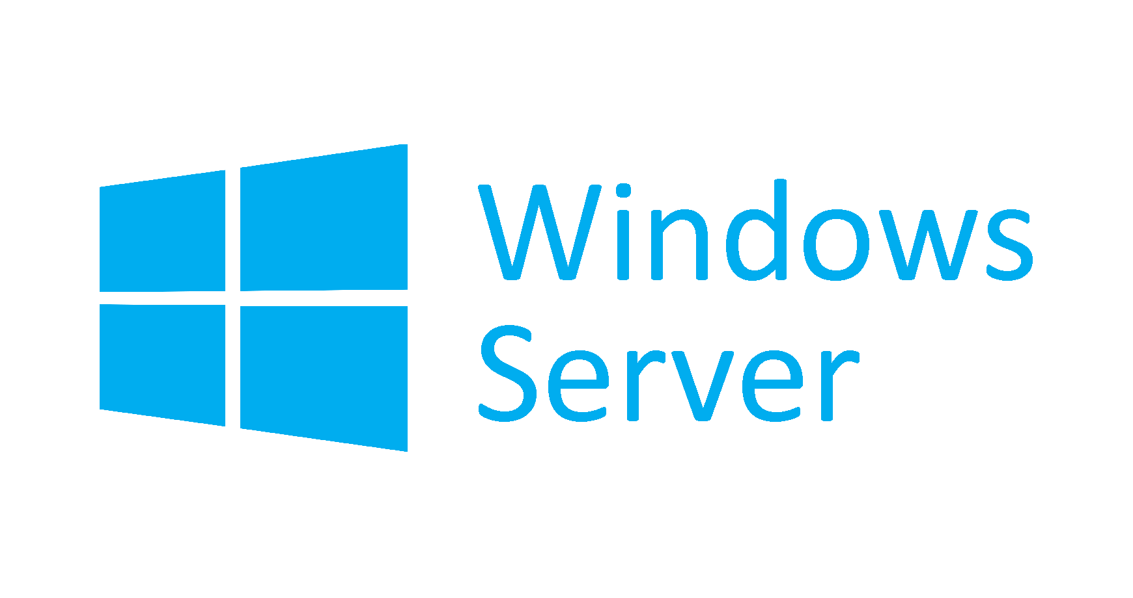

Password:
Cyberdeforg1!
Kali:
root / toor
Neo4j / toor

Slide 22
Links for nerds who look at these slides after.
https://github.com/BloodHoundAD/BloodHound
https://github.com/GoFetchAD/GoFetch
https://github.com/sense-of-security/ADRecon
https://bloodhoundgang.herokuapp.com/

Slide 23



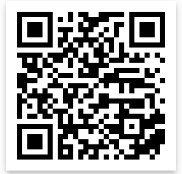
Cya Next week!
President of Center for Internet Security, Steve Spano Tuesday night, 7:15PM in BB129
Send your resume and a writing sample to mlim@albany.edu
Follow us on Twitter? Add on myInvolvement?
Gap week!
Introduction to Linux Security
- Friday 3pm BB123

